Slide 1

Business Report
Businesses are known to grow when they increase their trade volumes in the market. This includes selling of the existing products or services to existing customers

Slide 2

introduction

Slide 3
Chart
Chart:

Slide 4
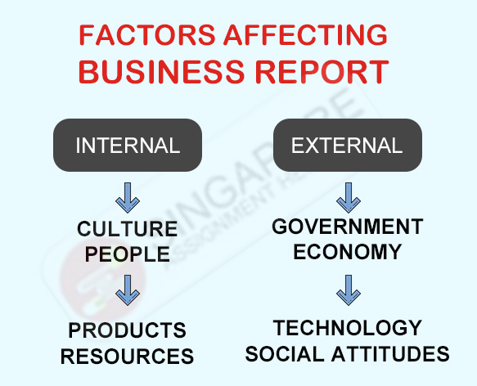
Factors
1: Customer Loyalty
2:Smart Adoption of Technology
3:# Commitment to Employee Training

Slide 5
Your best quote that reflects your approach… “It’s one small step for man, one giant leap for mankind.”
- Neil Armstrong

